Slide 1
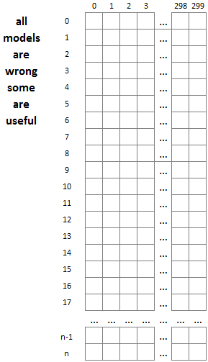
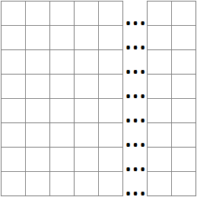
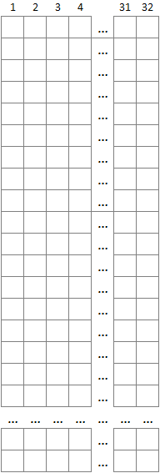
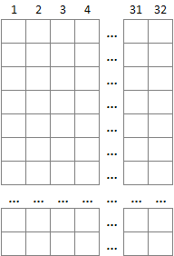
300 GloVe dimensions
1
pool_size = 2
2
kernel_size = 8
3
4
n = longest article in test set
25 classes,
one for each trained author
flatten
desne, 25 nodes, activation = ‘softmax’
5
desne, 10 nodes, activation = ‘relu’
6
…
32
embeddings layer
convolution layer
Conv1D, filters = 32, activation = ‘relu’
pooling layer
MaxPooling1D, pool_size=2
fully connected layers

